Slide 1
Land Art
A collaborative project with Dawn, Tia, Grace & Dexter

Slide 2
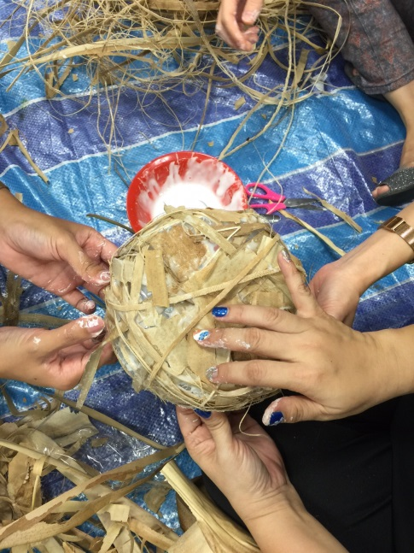
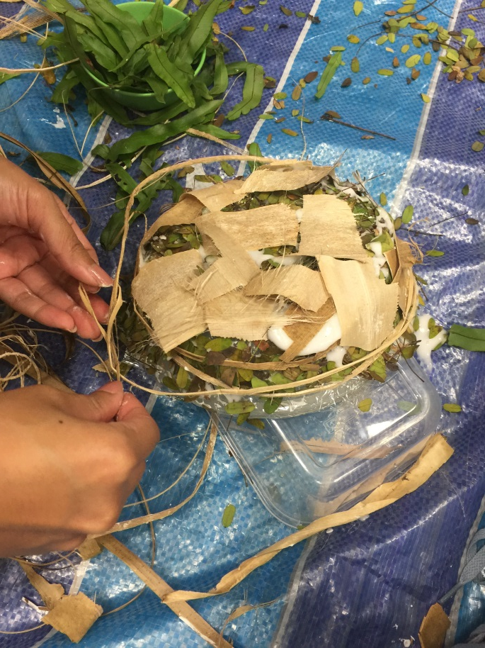
The challenges…
Keeping it together! Nature doesn’t seem to want to co-operate at times…

Slide 3
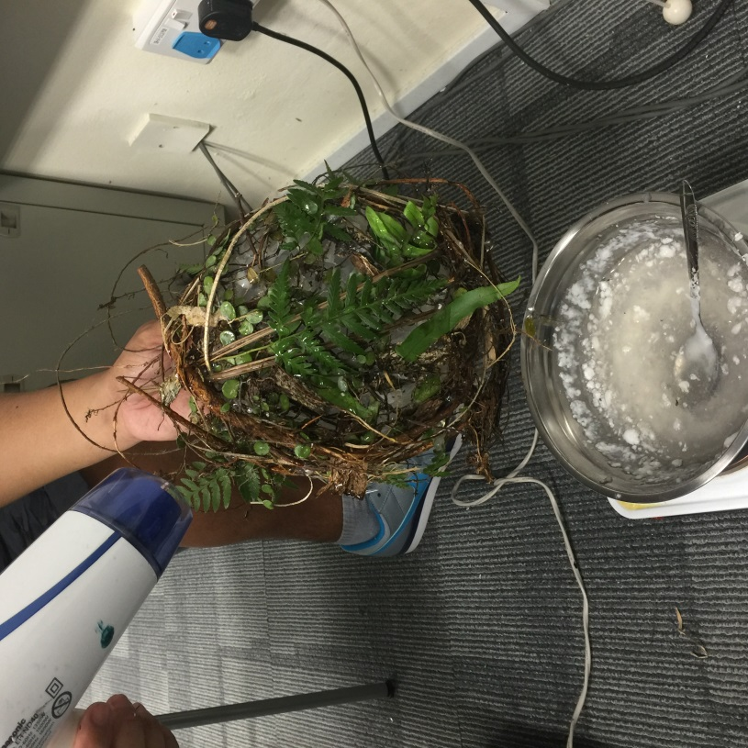
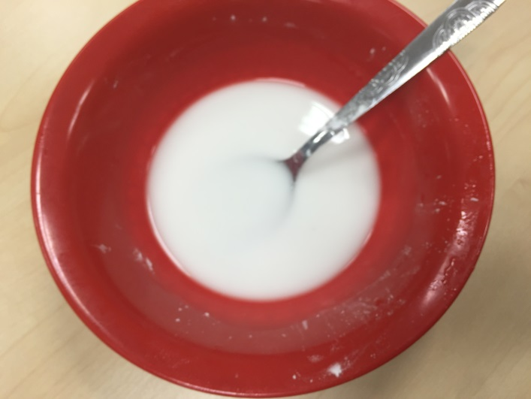
Exploration with materials and techniques…
Getting the right consistency…

Slide 4
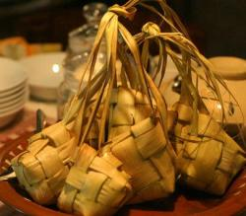
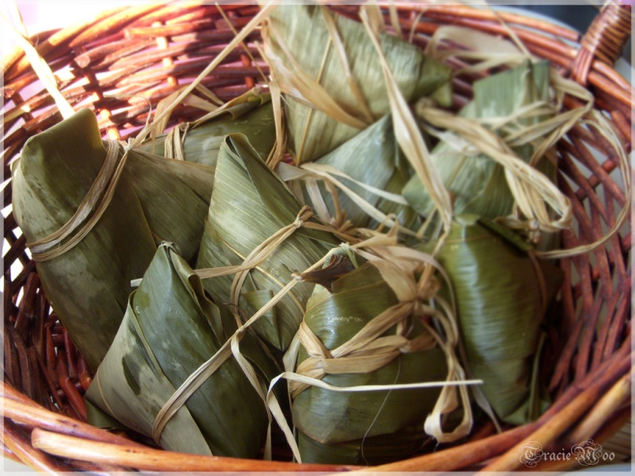
Cultural Influences…
Malay Influence: Ketupat
Chinese Influence: Nonya Dumpling

Slide 5
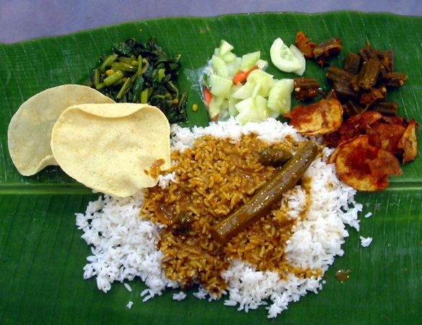
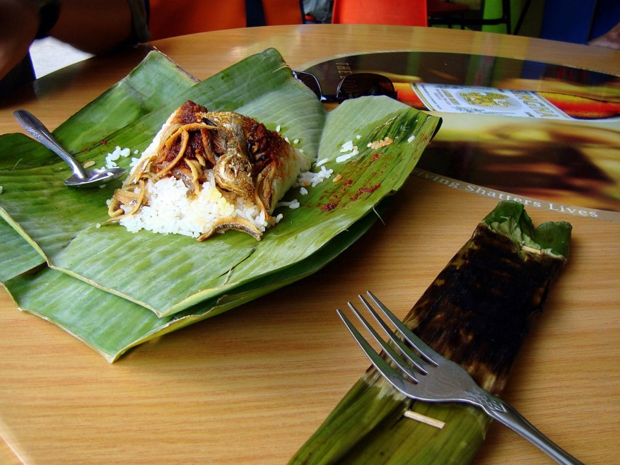
Indian and Malay Influence: Food served/wrapped in Banana Leaf.

Slide 6
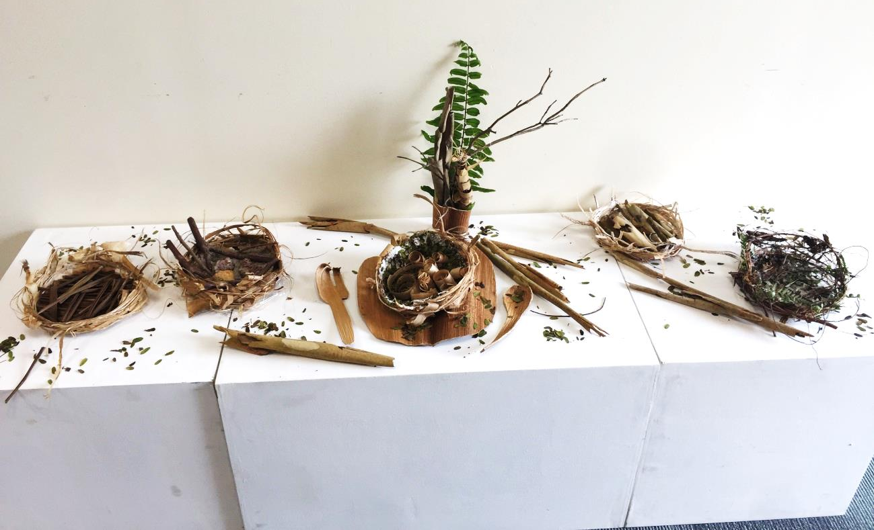
Our collaborative artwork…

Slide 7
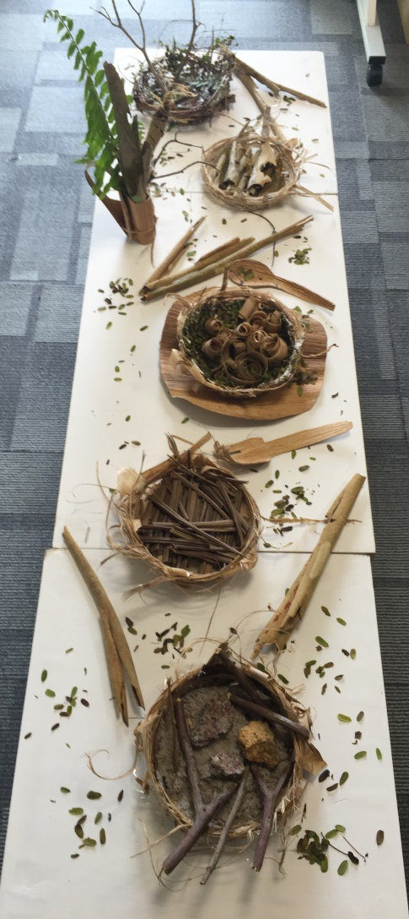
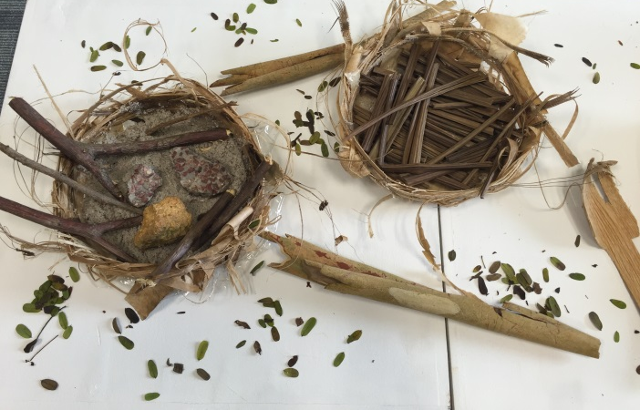

Slide 8
Reflections…
To create awareness of ecological values through collaborative work. Bringing students closer to nature.

